Slide 1
Repetition Structure II
for loop and flow control

Slide 2

Objectives
At the end of this lecture, you will ….
Be able to code using for loop
Be able to alter the program flow of loops with break and continue statements
Notes:
At the end of this lecture you will be able to use for loop in your code and also alter the program flow of loops with break and continue statements.

Slide 3
for loop

Slide 4
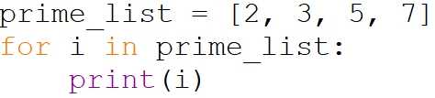
for Loop
Retrieve item from list
Executes the block of statements in the loop if there is item
Repeat from step 1 until all items in the list have been iterated
for item in list:
statement
statement
False
Next item
True
block of statements
Notes:
A for loop example

Slide 5
range
range is an immutable(non-modifiable) sequence type (list is also a sequence type) that represents arithmetic progression
To generate the range sequence, range() is called.
range is especially useful when we need to iterate over a sequence of numbers in loops
Notes:
Range is an immutable(non-modifiable) sequence type (list is also a sequence type) that represents arithmetic progression. To generate range sequence, the range method is called.
Range method is especially useful when we need to iterate over a sequence of numbers in loops.

Slide 6
range
range(stop)
range(start, stop)
range(start, stop, step)
Start: Starting number of the sequence
Stop: Generate numbers up to, but not including this number
Step: difference between each number(increment)2,4,6
Parameters can be passed in range() to determine the range of sequence generated
All parameters must be integers
All parameters can be positive or negative
Notes:
It is possible to pass parameters in the range method to determine the range of sequence generated
All parameters passed must be integers.
All parameters passed can be positive or negative.

Slide 7
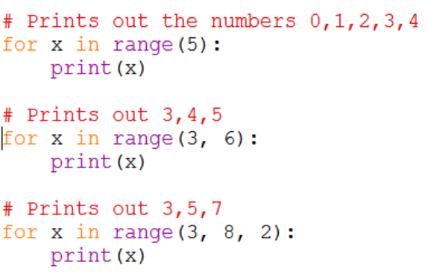
for Loop with range() - examples
Notes:
Example of loops with range method.
First example shows range method with a stop parameter
Second example shows range method with a start and stop parameter
Third example shows range method with a start , stop and step parameter. Notice how 4 and 6 are being omitted due to the step parameter

Slide 8
Loops – temperature sensor example
A room is installed with sensor that measures the temperature at an hourly interval.
Create a list that stores 24 temperature readings.
For each of the following techniques, calculate the average temperature reading for the day.
1) Use a while loop
3) Use a for loop with range
2) Use a for loop
Notes:
Let us see the following examples of using a while loop, a for loop with range and a for loop to write this temperature sensor example in the following slides

Slide 9
Solution with while loop
temp_list = [ 20.1, 24, 27.3, 30.1, 26.4, 22.2, 20.1, 24, \
27.3, 30.1, 26.4, 20.1, 24, 27.3, 30.1, 26.4, \
20.1, 24, 27.3, 30.1, 26.4, 20.1, 24, 27.3 ]
total = 0
i = 0
while i < len(temp_list):
total = total + temp_list[i]
i = i + 1
average = total / len(temp_list)

Slide 10
Solution with for loop using range
temp_list = [ 20.1, 24, 27.3, 30.1, 26.4, 22.2, 20.1, 24, \
27.3, 30.1, 26.4, 20.1, 24, 27.3, 30.1, 26.4, \
20.1, 24, 27.3, 30.1, 26.4, 20.1, 24, 27.3 ]
total = 0
for i in range (0 , len(temp_list):
total = total + temp_list[i]
average = total / len(temp_list)

Slide 11
Trace Table for for loop with range
i from range sequence | Iteration | temp_list[i]
- | Before start
0 | 1 | temp_list[0], i.e. 20.1
1 | 2 | temp_list[2], i.e. 24
2 | 3 | 27.3
3 | 4 | 30.1
: | :
22 | 23 | 24
23 | 24 | 27.3
- | stop

Slide 12
Solution with for loop
temp_list = [ 20.1, 24, 27.3, 30.1, 26.4, 22.2, 20.1, 24,
27.3, 30.1, 26.4, 20.1, 24, 27.3, 30.1, 26.4,
20.1, 24, 27.3, 30.1, 26.4, 20.1, 24, 27.3 ]
total = 0
for i in temp_list:
total = total + i
average = total / len(temp_list)

Slide 13
Trace Table for for loop
i from temp_list | Iteration
 | Before start
20.1 | 1
24 | 2
27.3 | 3
30.1 | 4
26.4 | :
: | 23
27.3 | 24
- | stop

Slide 14
Control Flow
Break
continue

Slide 15
Activity 1 Temperature sensor using break
A room is installed with sensor that measures the temperature at an hourly interval.
Create a list that stores 24 temperature readings.
With a for loop, check if any reading exceeds 25 degrees Celsius. If so, print a warning message and end the loop

Slide 16
Part 1 using for loop and break
temp_list = [ 20.1, 24, 27.3, 30.1, 26.4, 22.2, 20.1, 24,
27.3, 30.1, 26.4, 20.1, 24, 27.3, 30.1, 26.4,
20.1, 24, 27.3, 30.1, 26.4, 20.1, 24, 27.3 ]
A = 25
B = 0
for i in temp_list:
if i > A:
print('Over')
break

Slide 17
Part 2 using for loop with range and break
temp_list = [ 20.1, 24, 27.3, 30.1, 26.4, 22.2, 20.1, 24,
27.3, 30.1, 26.4, 20.1, 24, 27.3, 30.1, 26.4,
20.1, 24, 27.3, 30.1, 26.4, 20.1, 24, 27.3 ]

Slide 18
Activity 2 Temperature sensor using continue
A room is installed with sensor that measures the temperature at an hourly interval.
Create a list that stores 24 temperature readings.
Then, for each of the following techniques, calculate the average temperature reading for the day.
With a for loop with continue, find the highest reading of the day.

Slide 19
Part 1 using for loop and continue
temp_list = [ 20.1, 24, 27.3, 30.1, 26.4, 22.2, 20.1, 24,
27.3, 30.1, 26.4, 20.1, 24, 27.3, 30.1, 26.4,
20.1, 24, 27.3, 30.1, 26.4, 20.1, 24, 27.3 ]

Slide 20
Part 2 using for loop with range and continue
temp_list = [ 20.1, 24, 27.3, 30.1, 26.4, 22.2, 20.1, 24,
27.3, 30.1, 26.4, 20.1, 24, 27.3, 30.1, 26.4,
20.1, 24, 27.3, 30.1, 26.4, 20.1, 24, 27.3 ]

Slide 21
Summary
A for loop can be used to iterate through a list of items
The break statement breaks out of the for loop
The continue statement skips the remaining part of the loop body and proceed with the next loop

Slide 22
Reading Reference
Python 3.x Documentation
https://docs.python.org/3/tutorial/controlflow.html
Learn Python Tutorial
https://www.learnpython.org/en/Loops

